Slide 1
Solving Problems with Angles and Parallel Lines
www.achildsguideto.com

Slide 2

Starter Activity
Answers
5°
53°
P=12k - 2
340 cm
$$Area=10x^{2} −16x −96$$

Slide 3
Key vocabulary
Copy these down into your book
Alternate
Corresponding
Parallel
… and now, we begin…

Slide 4
Alternate Angles
These angles are the same.
Parallel lines
Notes:
4

Slide 5
Alternate Angles
These angles are the same.
Parallel lines

Slide 6
Examples of Alternate Angles

Slide 7
Corresponding Angles
The yellow angles are the same
The red angles are the same
The green angles are the same
The blue angles are the same

Slide 8
Corresponding Angles
Corresponding angles are sometimes called F-angles. This is just an aide memoire and should never be written in an exam.

Slide 9
Corresponding Angles

Slide 10
Application of Knowledge
Calculate the missing angles and give the reasons why.
Answers
a= 63° (Alternate)
b= 63° (Corresponding)
c= 23° (Angles on a straight line, Angles in a triangle)
d= 53° (Alternate angles gives d+45, then take 45)

Slide 11
Practice Page
Give angles and reasons
Answers
f= 113° (Alternate to given angle)
e= 113° (Corresponding to angle f)
g= 117° (Corresponding to given angle)
h= 113° (Corresponding to angle g)
j= 113° (Alternate to angle h)

Slide 12
Application
AB and CD are two parallel line segments.
E is the midpoint of AB.
EF is a line segment that runs at an angle of 55°, crossing CD at point G.
CE is a line segment that is perpendicular to EF.
Calculate the size of the following angles and give reasons:
DGF?
EGC?
AEC?
ECG?
CGF?
EGD?
Answers
DGF = 55° (Corresponding to BEG)
EGC = 55° (Alternate to BEG)
AEC = 35° (Angles on a straight line)
ECG = 35° (Alternate to AEC)
CGF = 125° (Angles on a straight line)
EGD = 125° (Alternate to AEG)

Slide 13
Language
Answers
Copy out the description filling in the blanks.
AB and ______ are two ___________ line segments.
E is the ____________ of AB.
EF is a line ____________ that runs at an ________ of 55°, crossing CD at _________ G.
CE is a line segment that is _______________ to EF.
CD
parallel
midpoint
segment
angle
point
perpendicular

Slide 14
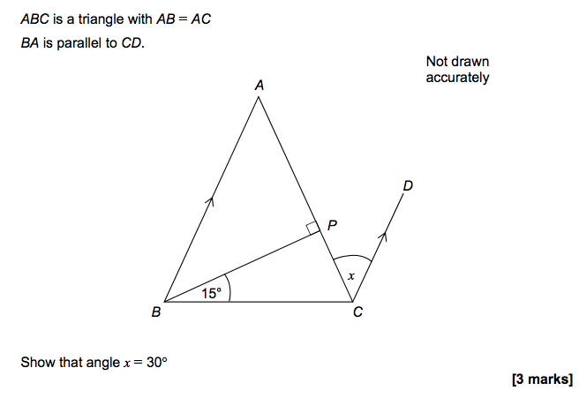
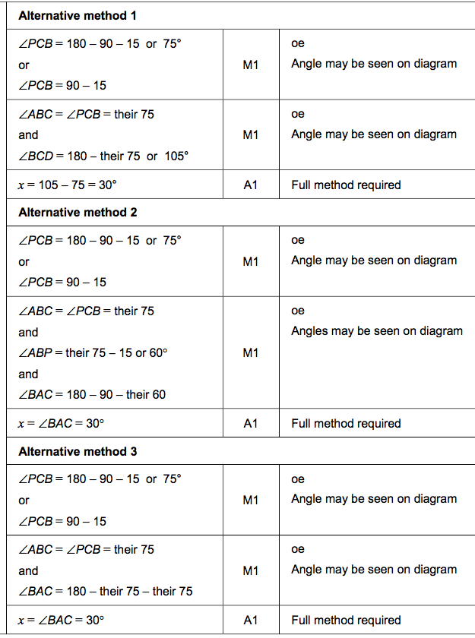
Exam Questions
[3 marks]

Slide 15
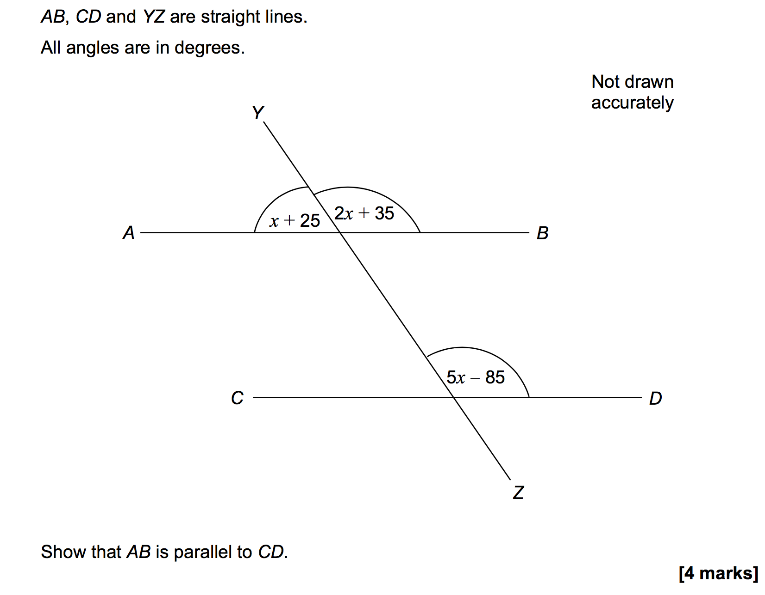
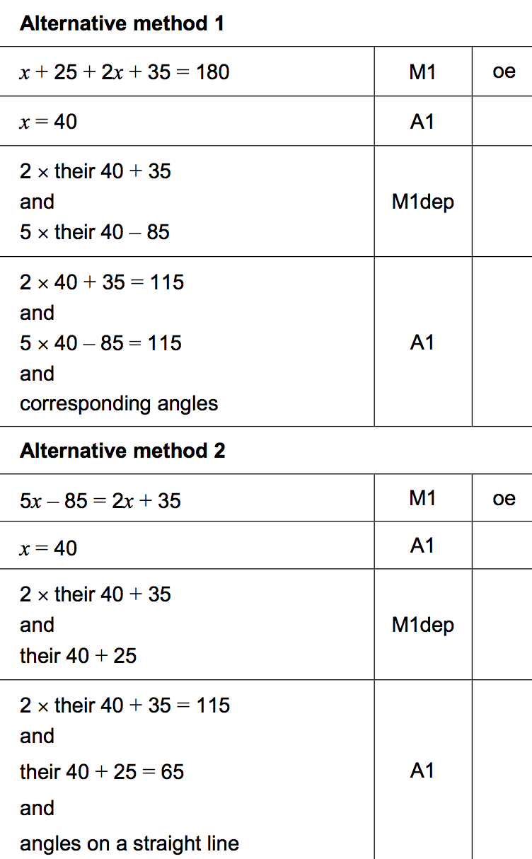
Exam Questions

Slide 16
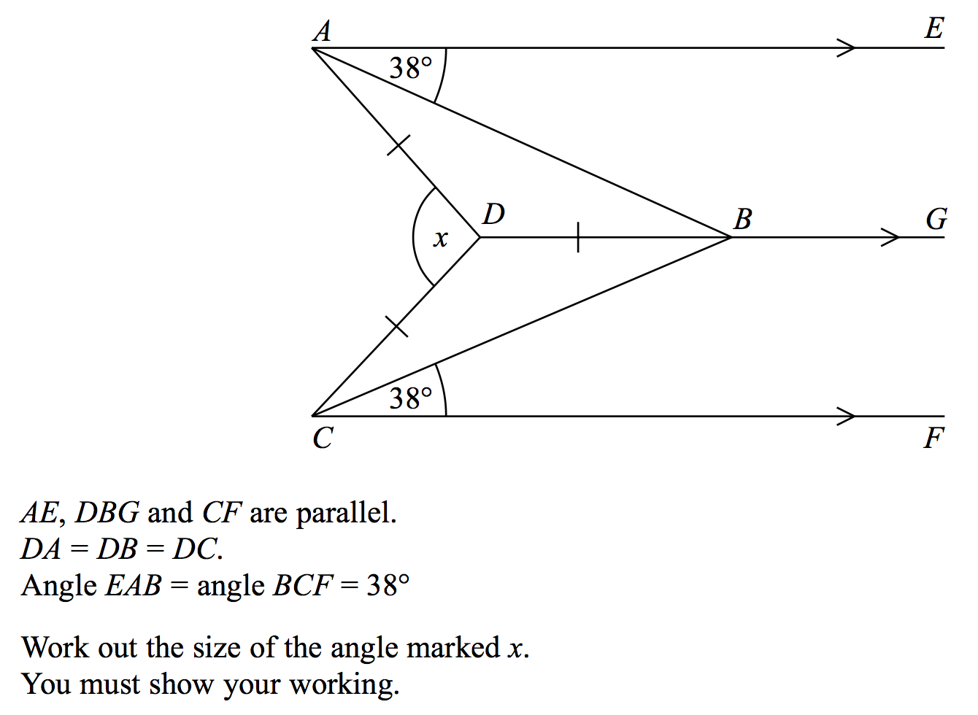
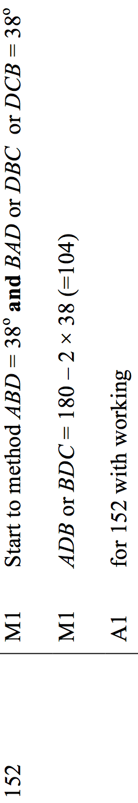
Exam Questions
[3 marks]

Slide 17
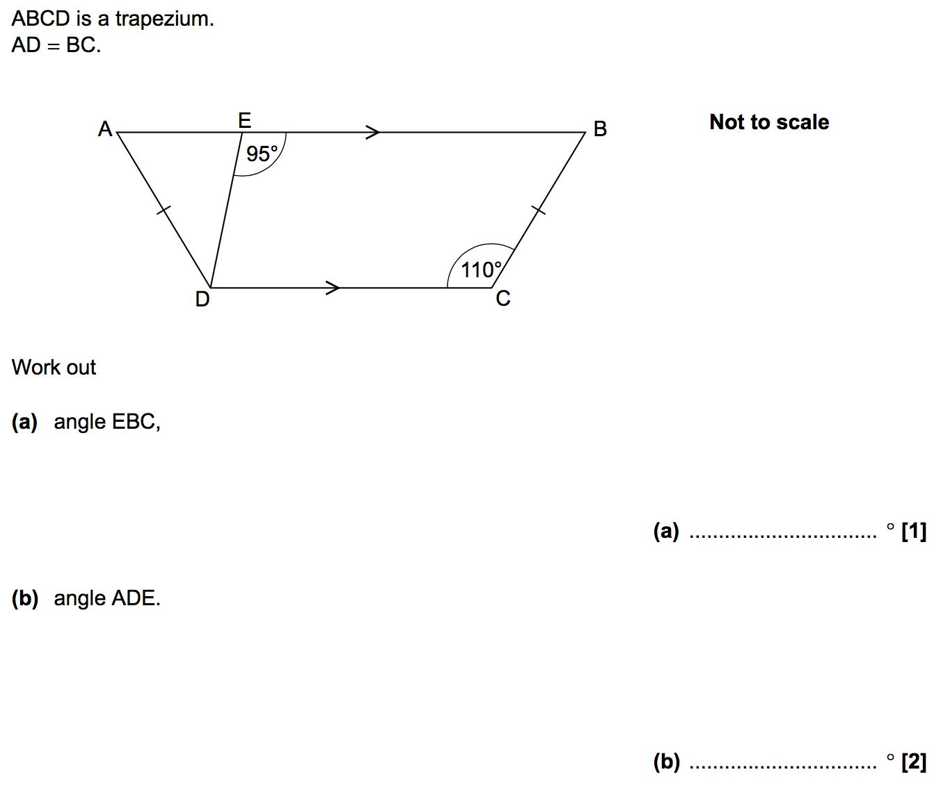
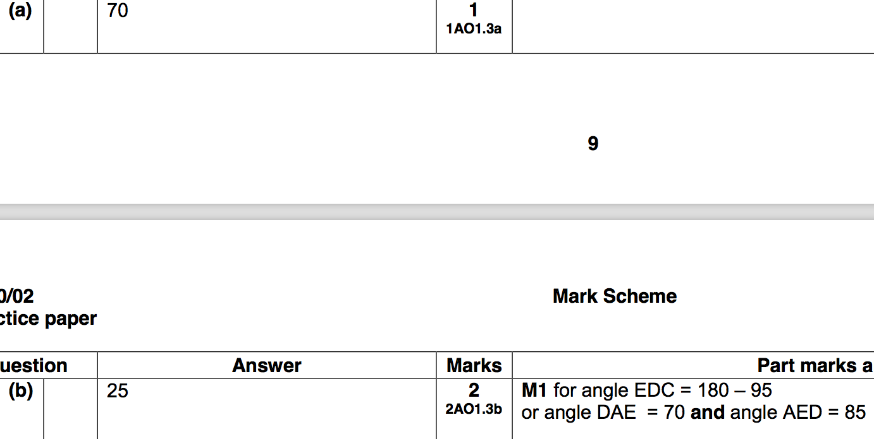
Exam Questions

Slide 18
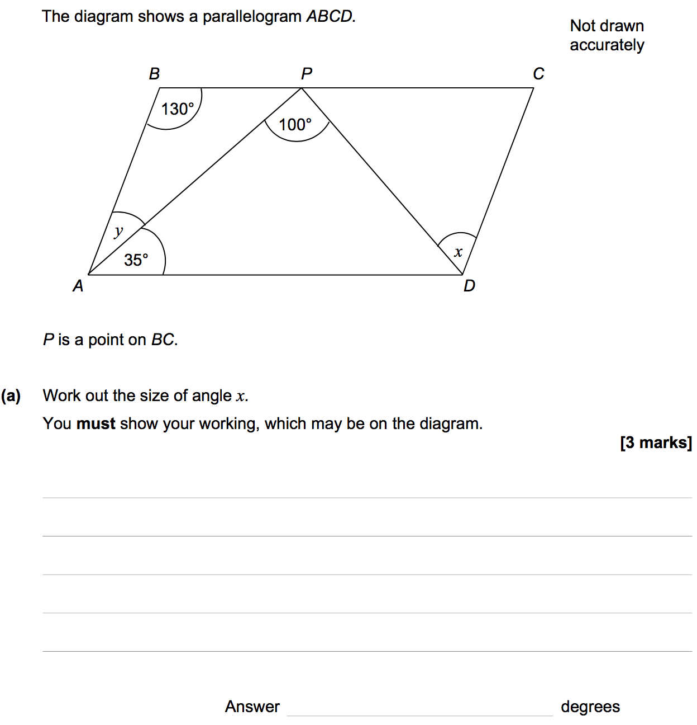
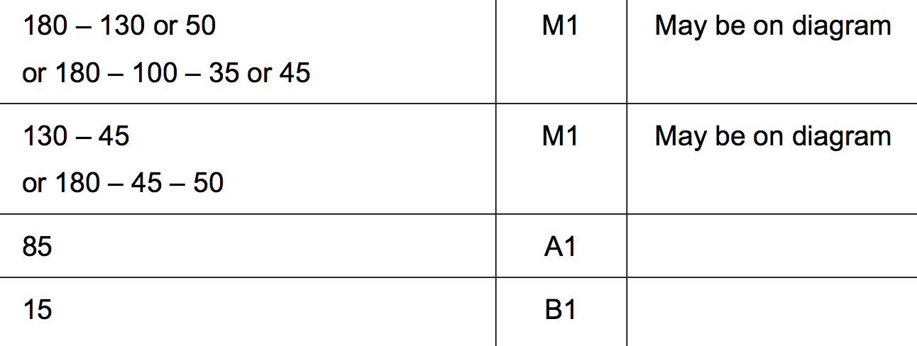
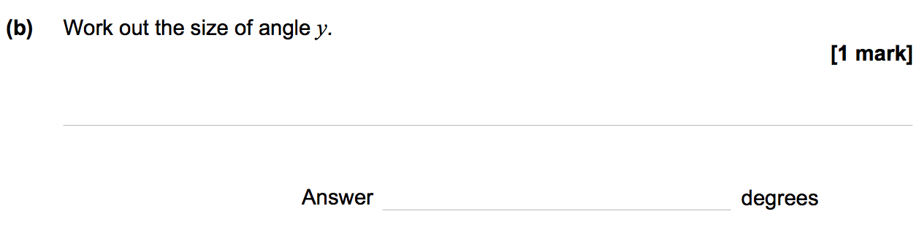
Exam Questions

